Slide 1
Unsupervised Anomaly Detection in a Large Corporate Network
Presented by : Mohammad Ariful Islam (Masters in CS, Dalhousie University)
Supervisor : Dr. Shahrear Iqbal, Dr. Scott Buffet

Slide 2
Roadmap
Anomaly Detection
Dataset Preview
Dataset Preprocessing
Application of Anomaly detection

Slide 3
Anomaly Detection
What is anomaly detection
Finding outlying records in the dataset.
Typically very rare in the dataset.
Significantly deviated from the normal data of the dataset.
Important for real world applications
Notes:
hello

Slide 4

Unsupervised Anomaly Detection in a Large corporate Network
Find anomaly in a large corporate network dataset.
Large dataset contains noise!
Instrintict information of the whole data

Slide 5
Our Dataset
Dataset of the events from a large enterprise corporation.
Data from various flow over the course of 90 days.
Network flow data
Host event data
Reference : https://csr.lanl.gov/data/2017.html

Slide 6
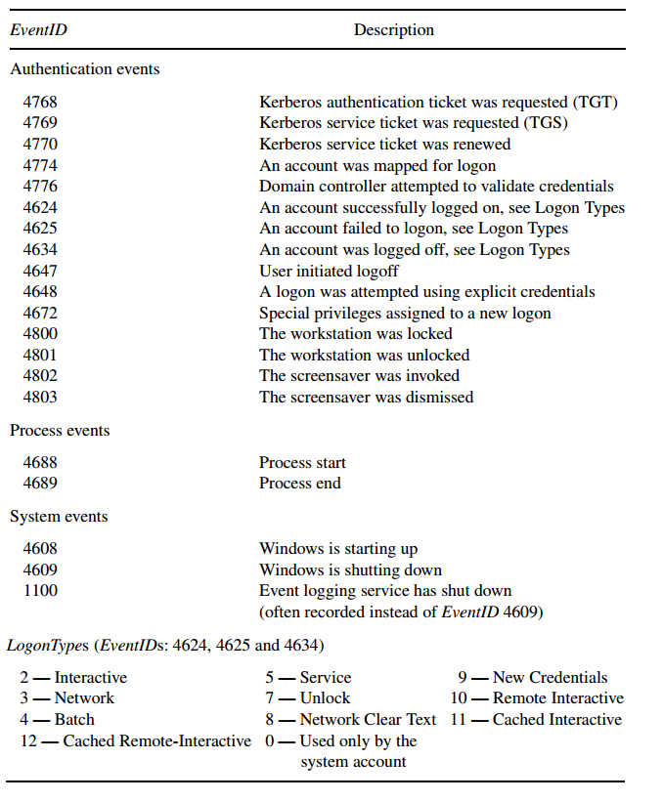
Host Event Data logs

Slide 7
Dataset preprocessing
Appropriate preprocessing is necessary.
It provides flexibility and accuracy.
Prepare an ‘Algorithm ready’ dataset

Slide 8
Dataset preview after preprocessing
Original Dataset Processed dataset
{"EventID": 4769, "UserName": "User624729", "Status": "0x0", "Source": "Comp309534", "Computer": "ActiveDirectory", "Time": 2}
{"EventID": 4776, "UserName": "Scanner", "Status": "0x0", "AuthenticationPackage": "MICROSOFT_AUTHENTICATION_PACKAGE_V1_0", "Time": 2}
{"EventID": 4672, "UserName": "ActiveDirectory$", "LogonID": "0x2e66398d", "ActiveDirectory", "Time": 2}
Host | Day No. | Feature of Events
Comp329292 | 1 | 0,0,0,0,0,0,0,17,0,52,0,0,0,0,0,0,0,0,0,0,0,0…..
Comp697547 | 1 | 0,0,0,0,0,1,1,19,0,36,2,0,0,0,0,0,0,0,0,0,0,0,0,0,0,0,0...
Comp952193 | 2 | 0,0,0,0,0,0,0,17,0,28,6,0,0,0,0,0,0,0,0,0,0,0,0,0...
Comp089593 | 6 | 0,0,0,0,88,0,0,109,0,31,24,0,0,0,0,0,0,0,5,0,0...

Slide 9
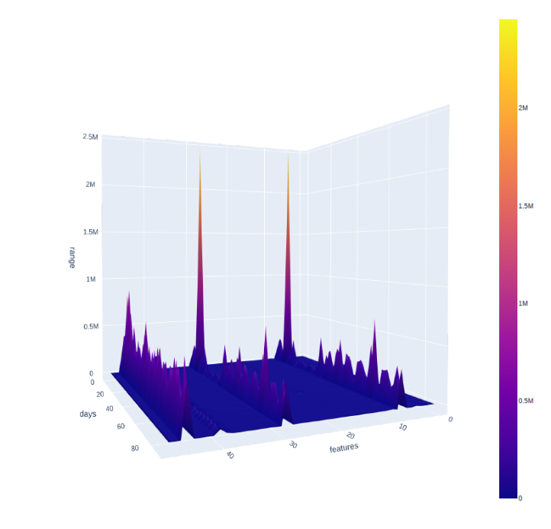
Experiment - 1 : Summation
Enables the visualization of the entire dataset

Slide 10
Experiment - 2 : Principal Component Analysis
An approach for reducing the dimensionality of high dimensional dataset
It also keep the maximum information even after reducing the weight
It increases the understandability of the dataset

Slide 11
What we get
Dimension of the features | Remaining information
50 | 100.00 %
40 | 100.00 %
30 | 99.97 %
25 | 99.64 %
20 | 97.69 %
17 | 95.01%
12 | 86.00 %
10 | 80.00 %

Slide 12
Selection of Anomaly Detection Algorithm
The choice of using appropriate anomaly detection algorithms is crucial.
Our tested anomaly detection methods are :
K- nearest neighbour (KNN)
Local outlier factor (LOF)
One class support vector machine (OCSVM)
Isolation forest (IF)

Slide 13
Isolation Forest (IF)
Isolation Forest produces the expected results.
It ‘Isolates’ the anomaly points from the original data.
IF requires less memory and processing power compared to other algorithms.

Slide 14
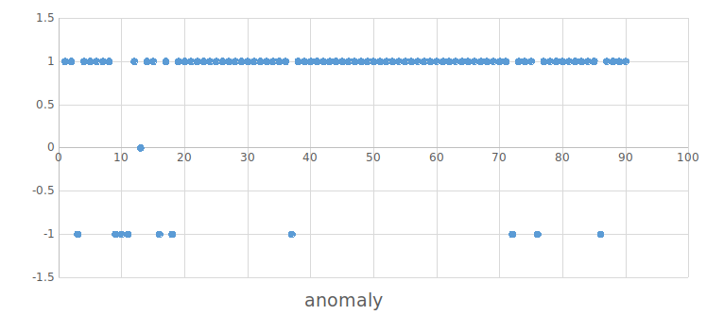
Initial Evaluation
Anomalous day: 3,9,10,11,13,16,18,37,72,76,86

Slide 15
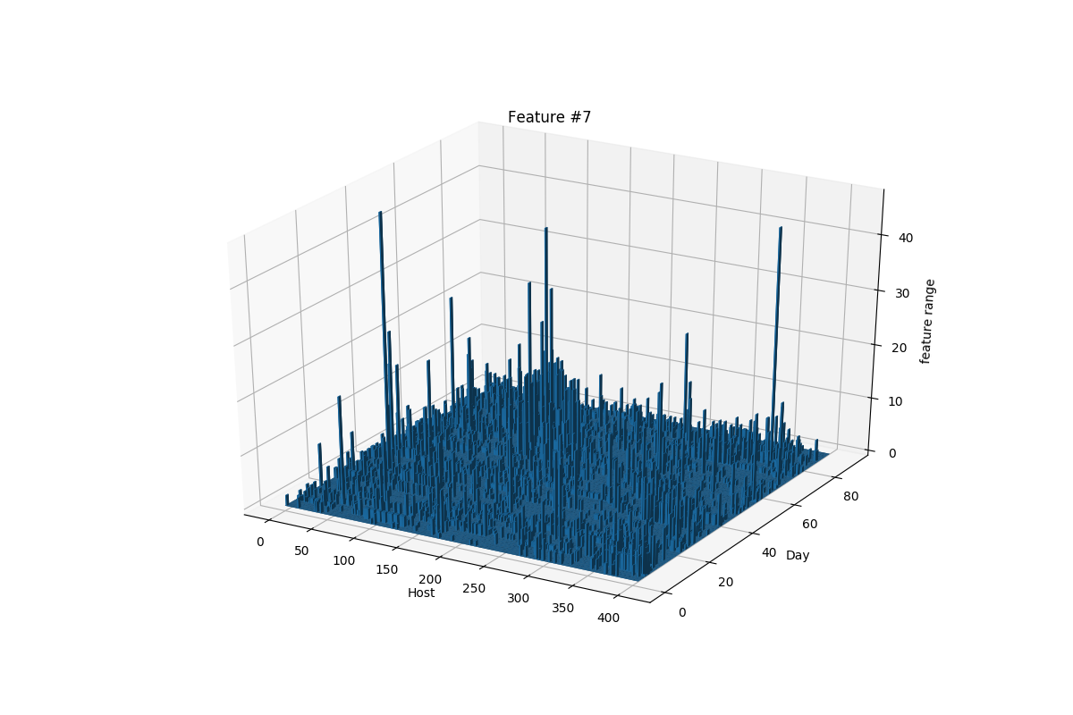
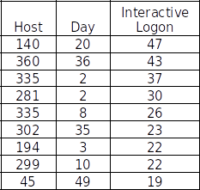
Successfully Logged on Events
Reason: Two users logged on using the local logon prompt 47 times within 71 minutes

Slide 16
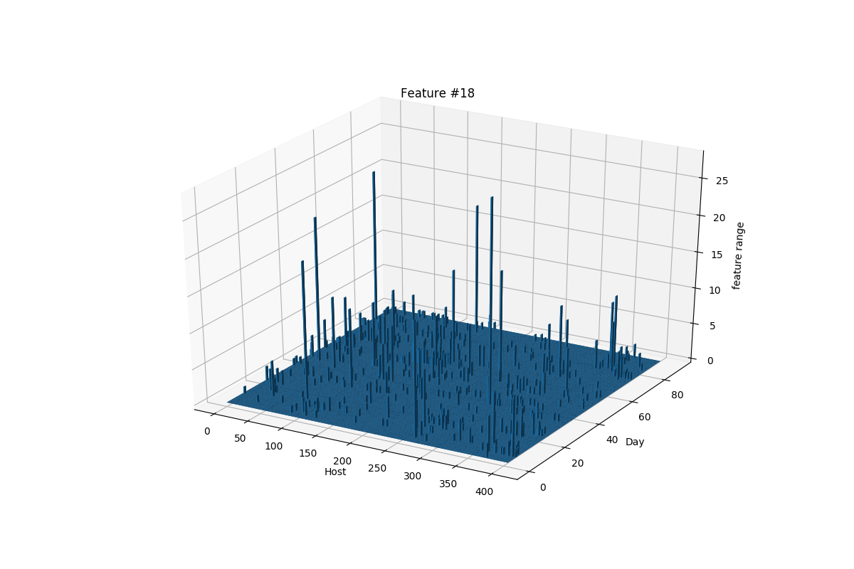
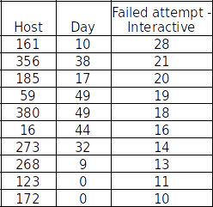
Failed to Log On Event
Reason: "User057900“ and "User159527“ tried to log in within 95 minutes. Failed 28 times.

Slide 17
Host Specific Anomaly Detection
Host , Day | Anomaly Scores | Anomaly existence
(U1,D1) | 0.163391567088028 | None
(U1,D2) | 0.282482140185619 | None
(U1,D10) | 0.393524736577778 | Yes
(U20,D20) | 0.173806796932657 | None
(U25,D50) | 0.203360706445466 | None
(U300,D86) | 0.400388998137896 | Yes
(U406,D90) | 0.224989271767493 | None

Slide 18
Possible Directions for Future works
Optimization of the Algorithm for the dataset to reduce time consumption.
More data views : Specific time for each host.
Experiment with sequence clustering techniques to detect anomalous sequence.
Research methods on finding reasons for anomalies.

Slide 19
Conclusion
We have found the way to detect anomalies from a large corporation dataset.
We can determine the specific anomaly point out of the dataset
The data preprocessing makes it easier to apply anomaly detection technique.
Isolation Forest is a useful algorithm for this kind of dataset to find out accurate results.

Slide 20
THANK YOU
Mohammad Ariful Islam • Masters in Computer Science,Dalhousie University • Mohammad.Ariful.Islam@nrc-cnrc.gc.ca

